Slide 1
IBM Hackaton - Roadside Rescue
Group: CS551/PG1
By: Michael Rzepka, Haritha Rao, Wang Zhang, and Ran Chen

Slide 2
Abstract
The core idea behind the Roadside Rescue hackathon project is the automation of roadside assistance services using IoT (Internet of Things) sensor data, a layer of intelligent heuristics over that data, and publishing the resulting knowledge through a reliable and real-time cloud based system.
This would allow companies currently offering roadside assistance services (Geico, Progressive, AAA, etc.) automation tooling to improve the efficiency of the services offered, and ultimately save money by collecting aggregated analytics the generated data.

Slide 3
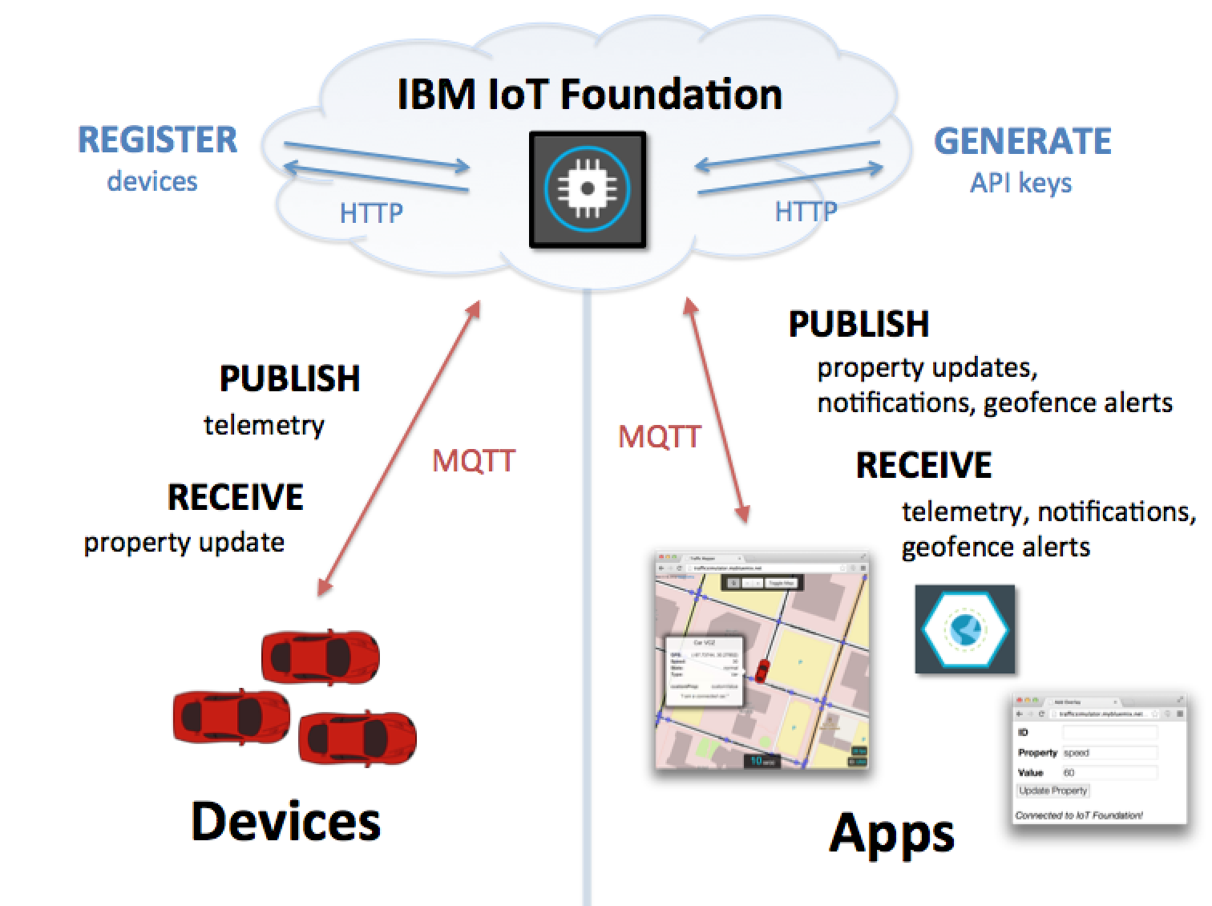
Framework Structure
+ Heuristics

Slide 4
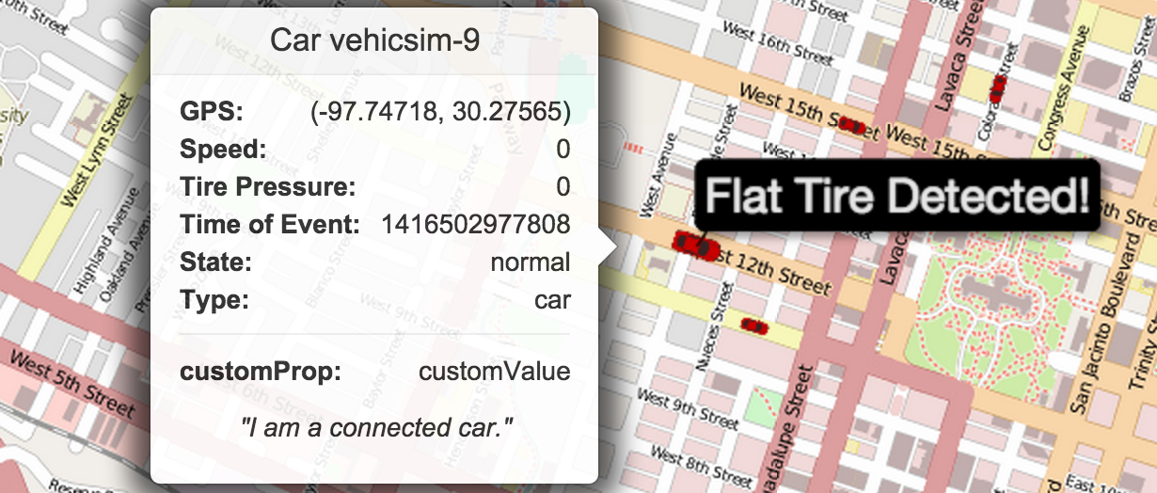
Tire Pressure Example

Slide 5
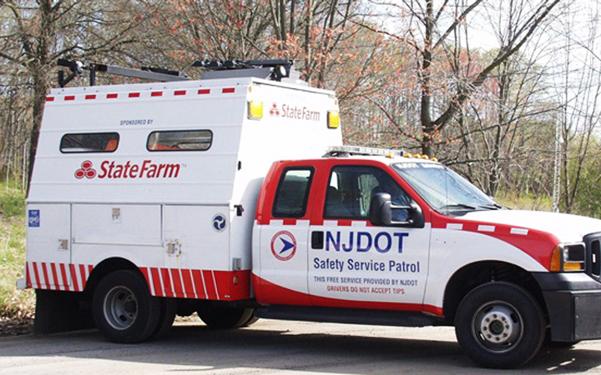
Automated Notification Service
Signal →

Slide 6
Analytics Reporting
Based on the event driven data, analytics can be run against efficiency and cost effective metrics as batch processing
Can ask questions like:
Do we have enough service centers based on the most common event areas?
What are the desirable/expected response times?
Possible preventative actions?

Slide 7
Heuristic Knowledge Base
Can be expanded to a number of other scenarios:
Fuel tank sensors
Airbag deployment sensors
Key in ignition + doors locked + not moving + duration
The expansion limitations are based purely upon the sensor data generated and the rules around how events are generated.

Slide 8

Device Allocation on Subscription
Feasibility of generating sensor data for a set of vehicles can be based upon subscription of service with specific company.
Very similar to the idea of Progressive’s “Snapshot” sensor

Slide 9
Demo of Tire Pressure Example
http://roadside-rescue.mybluemix.net/
Built on the framework of http://m2m.demos.ibm.com/trafficsimulator.html

